Slide 1


Data Analysis for Social Buzz:
Uncovering Key Insights to Drive Growth and IPO Readiness

Slide 2


Today's agenda
Project recap
Problem
The Analytics team
Process
Insights
Summary

Slide 3

Social Buzz is a fast-growing social media and
content creation technology unicorn that needs to
adapt quickly to its global scale. Accenture has
begun a 3-month POC focusing on these tasks:
• An audit of Social Buzz’s big data practice
• Recommendations for a successful IPO
• Analysis to find Social Buzz’s top 5 most popular categories of content
Project Recap

Slide 4

Problem
Over 100,000 posts per day
36,500,000 pieces of content per year!
But how to capitalize on it when there is so much?
Analysis to find Social Buzz’s top 5 most popular categories of content

Slide 5



Michell Grove
Chief Technical Architect
The Analytics team
Marcus Rompton
Senior Principle
Jrandy Minoza
Data Analyst

Slide 6
Process
1
Data Understanding
2
Data Cleaning
3
Data Modeling
4
Data Analysis
5
Uncover Insights

Slide 7

Insights
16
1,897
MAY
REACTIONS TO ‘ANIMAL’ POSTS
MONTH WITH THE MOST POSTS
UNIQUE CATEGORIES

Slide 8
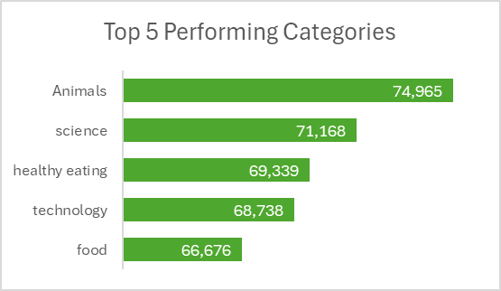
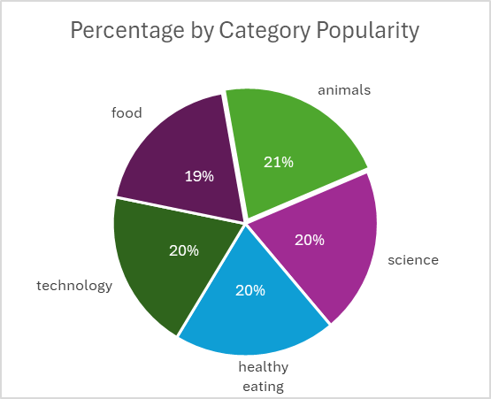

Slide 9
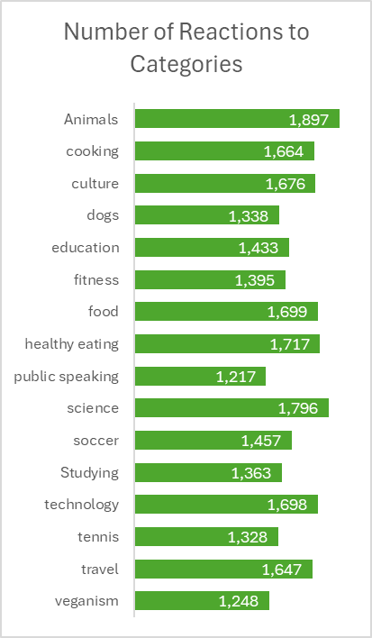
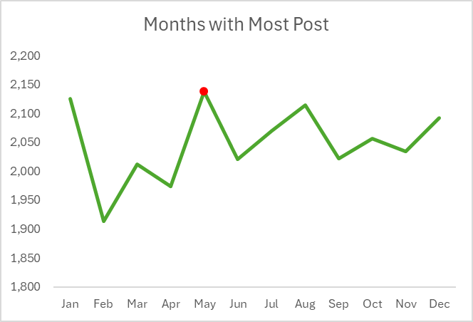

Slide 10

ANALYSIS
It reveals that “Animals” is the most popular category with the highest number of reactions, indicating a strong interest in animal-related content.
INSIGHT
Identifying “May” as the month with the most posts provides an opportunity to explore why and capitalize on this trend has the most posts.
Summary
NEXT STEPS
This ad hoc analysis is insightful, but it’s time to turn it into large-scale production for a real-time understanding of your business. We can show you how to do this: Content Strategy Optimization, Further Data Analysis, and Ongoing Support.

Slide 11
Thank you!
ANY QUESTIONS?

